Slide 1
Chapter 2
Symmetric Encryption
&
Message Confidentiality

Slide 2
Symmetric Encryption
or conventional / private-key / single-key
sender and recipient share a common key
all classical encryption algorithms are
private-key
was only type prior to invention of publickey in 1970’s
and by far most widely used

Slide 3
Outline
Symmetric Encryption Principles
Symmetric Encryption Algorithms
Random and Pseudorandom Numbers
Stream Ciphers and RC4
Cipher Block Modes of Operation
Location of Encryption Devices
Key Distribution

Slide 4
Some Definitions
Cryptography: Science of secret writing
Plaintext: Original message
Ciphertext: Transformed message
Encryption:plaintext -> ciphertext process
Decryption:ciphertext -> plaintext process
Key:Some critical information used by the cipher,known only to sender and/or receiver
Cryptanalysis:Attempting to discover plaintext or key or both
Cryptology:Study of both cryptography and cryptanalysis

Slide 5
2.1 Conventional（symmetric） Encryption Principles

Slide 6
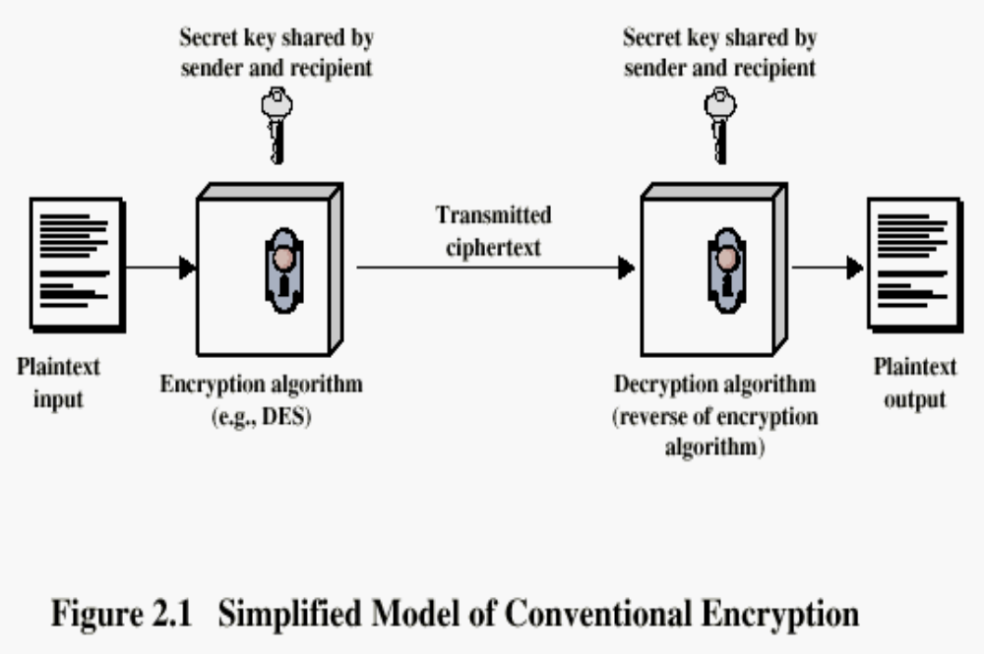
Simplified Model of Conventional Encryption
Notes:
Two requirement for secure use of conventional encryption:
A strong algorithm
Sender and receiver must have obtained copies of the secret key in a secure fashion and must keep the key secure.

Slide 7
An encryption scheme has five ingredients:
  Plaintext
  Encryption algorithm
  Secret Key
  Ciphertext
  Decryption algorithm

Slide 8
Two requirement for secure use of conventional encryption:
A strong algorithm;
the opponents are unable to decrypt ciphertext or discover key even in possession of some plaintext and ciphertext pairs.
Sender and receiver must have obtained copies of the secret key in a secure fashion and must keep the key secure.

Slide 9
It’s important to note that:
Security of symmetric encryption depends on the secrecy of the key, not the secrecy of the algorithm.
In other words:
We do not need to keep the algorithm secret,we only need to keep the key secret.

Slide 10
Cryptography
Classified along three independent dimensions:
  The type of operations used for transforming plaintext to ciphertext
  substitution,permutation
  The number of keys used
    symmetric (single key)
    asymmetric (two-keys)
  The way in which the plaintext is processed
  block cipher; stream cipher

Slide 11
– Substitution: Maps each plaintext element onto corresponding element of ciphertext element
明文
a
b
c
d
e
f
g
h
i
j
k
l
m
密文
W
J
A
N
D
Y
U
Q
I
B
C
E
F
明文
n
o
p
q
r
s
t
u
v
w
x
y
z
密文
G
H
K
L
M
O
P
R
S
T
V
X
Z
^{Computer->AHFKRPDM}

Slide 12
Permutation-
Rearranges the plaintext
x
1
2
3
4
5
6
π（x）
3
5
1
6
4
2
intern|etstan|dardsa|ndrfcs
351642 351642 351642 351642
tnirne|sneatt|radsad|rsncdf

Slide 13
Two major techniques for encryption
Symmetric Encryption
– Sender and receiver use same key (shared secret)
– Also known as: Conventional Encryption/ Secret Key Encryption
– Was the only method used prior to the 1970s
– Still most widely used
Public Key (Asymmetric) Encryption
– Sender and receiver use different keys
– Technique published in 1976

Slide 14
Other classifications
Block vs Stream Cipher
– Block cipher: processes a block of plaintext at a time,producing a corresponding block of ciphertext at a time (e.g. 64 or 128 bits,DES,AES)
– Stream cipher: processes input continuously (e.g. one bit at a time,RC4)

Slide 15
Strong Encryption
An encryption algorithm needs to be strong
This means that an attacker who knows:
– the algorithm
– some pieces of ciphertext
– some plaintext-ciphertext pairs (possibly)
cannot deduce:
– the plaintext, or
– the key

Slide 16
Cryptanalysis
objective to recover key not just message
general approaches:
  cryptanalytic attack: Exploit weaknesses in the algorithm or key; e.g. key generated from password entered by user,where user can enter bad password
  brute-force attack
if either succeed all key use compromised
Notes:
Typically objective is to recover the key in use rather then simply to recover the plaintext of a single ciphertext. There are two general approaches:
Cryptanalysis: relies on the nature of the algorithm plus perhaps some knowledge of the general characteristics of the plaintext or even some sample plaintext- ciphertext pairs. This type of attack exploits the characteristics of the algorithm to attempt to deduce a specific plaintext or to deduce the key being used.
Brute-force attacks try every possible key on a piece of ciphertext until an intelligible translation into plaintext is obtained. On average,half of all possible keys must be tried to achieve success.
If either type of attack succeeds in deducing the key, the effect is catastrophic: All future and past messages encrypted with that key are compromised.

Slide 17
Cryptanalytic Attacks
ciphertext only
  only know algorithm & ciphertext, is statistical, know or can identify plaintext
known plaintext
  know/suspect plaintext & ciphertext
chosen plaintext
  select plaintext and obtain ciphertext
chosen ciphertext
  select ciphertext and obtain plaintext
chosen text
  select plaintext or ciphertext to en/decrypt
Notes:
Stallings Table 2.1 summarizes the various types of cryptanalytic attacks, based on the amount of information known to the cryptanalyst, from least to most. The most difficult problem is presented when all that is available is the ciphertext only. In some cases, not even the encryption algorithm is known, but in general we can assume that the opponent does know the algorithm used for encryption. Then with increasing information have the other attacks. Generally, an encryption algorithm is designed to withstand a known-plaintext attack.

Slide 18
Brute Force Search
always possible to simply try every key
most basic attack, proportional to key size
assume either know / recognise plaintext
Key Size (bits) | Number of Alternative Keys | Time required at 1 decryption/µs | Time required at 10⁶ decryptions/µs
32 | 2³² = 4.3 × 10⁹ | 2³¹ µs = 35.8 minutes | 2.15 milliseconds
56 | 2⁵⁶ = 7.2 × 10¹⁶ | 2⁵⁵ µs = 1142 years | 10.01 hours
128 | 2¹²⁸ = 3.4 × 10³⁸ | 2¹²⁷ µs = 5.4 × 10²⁴ years | 5.4 × 10¹⁸ years
168 | 2¹⁶⁸ = 3.7 × 10⁵⁰ | 2¹⁶⁷ µs = 5.9 × 10³⁶ years | 5.9 × 10³⁰ years
26 characters (permutation) | 26! = 4 × 10²⁶ | 2 × 10²⁶ µs = 6.4 × 10¹² years | 6.4 × 10⁶ years
Notes:
A brute-force attack involves trying every possible key until an intelligible translation of the ciphertext into plaintext is obtained. On average, half of all possible keys must be tried to achieve success. Stallings Table 2.2 shows how much time is required to conduct a brute-force attack, for various common key sizes (DES is 56, AES is 128, Triple-DES is 168, plus general mono-alphabetic cipher), where either a single system or a million parallel systems, are used.

Slide 19
Is an unbreakable encryption scheme possible?
In theory, No!
– Except for the one-time pad technique, which is impractical in most situations
In practice, though, it is possible to have a scheme that is effectively unbreakable :
– i.e. the chances of someone breaking it are very close to zero.
– Such a system has :
No known weaknesses
A key with so many possible values that they can’t all be tried
An encryption scheme is computationally secure if:
– Cost of breaking the cipher exceeds value of information
– Time needed to break cipher exceeds lifetime of information( see table2.2)

Slide 20
Feistel Cipher Structure
Virtually all conventional block encryption algorithms, including DES have a structure first described by Horst Feistel of IBM in 1973
The realisation of a Fesitel Network depends on the choice of the following parameters and design features (see next slide):

Slide 21
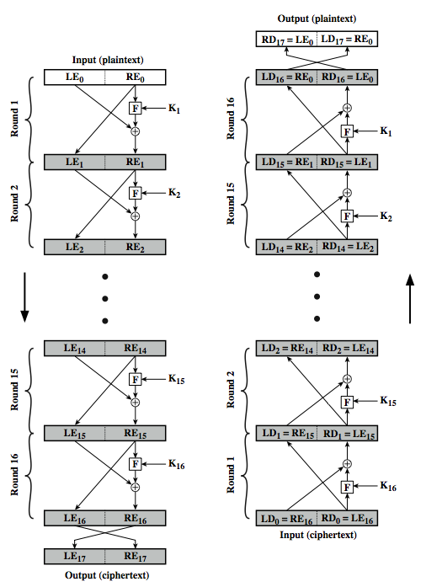
Feistel ENC.&DEC
(pp.33)

Slide 22
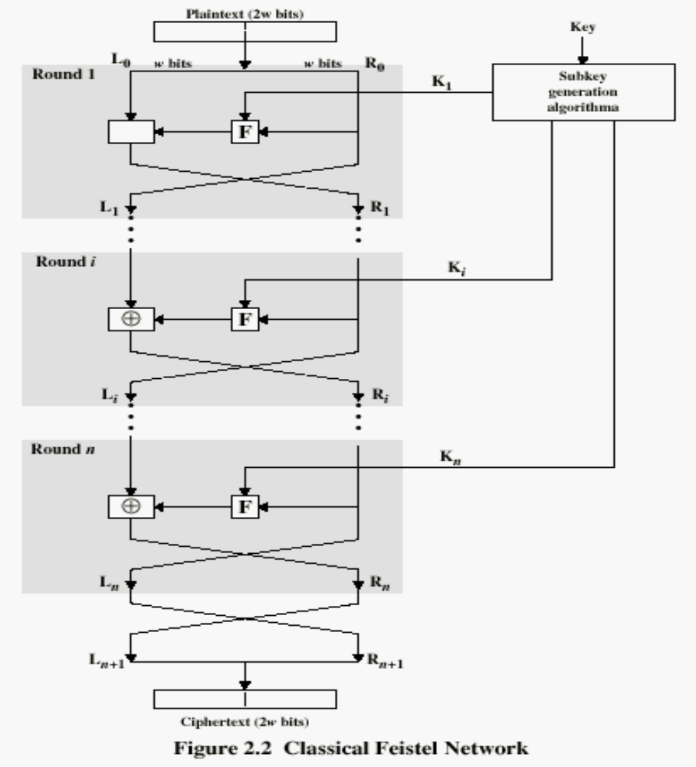
Notes:
Feistel Cipher
(1)Partitions block into two halves, L0 and R0
(2)Processes through n rounds
(3)Divide key into n subkeys, one per round
(4)At each round i:
– Perform substitution on current left half Li-1 by
XORing it with F(Ki, Ri-1 )
– F is known as the round function.
– Swap halves (this is a permutation)
(5) Basis of most modern block ciphers

Slide 23
Feistel Cipher Structure- parameters
Block size: larger block sizes mean greater security
Key Size: larger key size means greater security
Number of rounds: multiple rounds offer increasing security
Subkey generation algorithm: greater complexity will lead to greater difficulty of cryptanalysis.
Round function:

Slide 24
Feistel Cipher Structure- design features
Fast software encryption/decryption: when it is embeded in application or utility functions,the speed of execution of the algorithm becomes a concern
Ease of analysis:if a algorithm can be concisely and clearly explained,it is easier to analyze its vulnerabilities and develop high level of assurance to its strength.

Slide 25
2.2 Symmetric Encryption Algorithms
Data Encryption Standard (DES)
  The most widely used encryption scheme
  The algorithm is reffered to the Data Encryption Algorithm (DEA)
  DES is a block cipher
  The plaintext is processed in 64-bit blocks
  The key is 56-bits in length
Notes:
Partitions block into two halves, L0 and R0, then Processes through n rounds
Divide key into n subkeys, one per round
At each round i:
– Perform substitution on current left half Li by
XORing it with F(Ki, Ri )
– F is known as the round function.
– Swap halves (this is a permutation)
Basis of most modern block ciphers

Slide 26
DES Design Controversy
although DES standard is public
was considerable controversy over design
  in choice of 56-bit key (vs Lucifer 128-bit)
  and because design criteria were classified
subsequent events and public analysis show in fact design was appropriate
use of DES has flourished
  especially in financial applications
  still standardised for legacy application use
Notes:
Before its adoption as a standard, the proposed DES was subjected to intense & continuing criticism over the size of its key & the classified design criteria.
Recent analysis has shown despite this controversy, that DES is well designed. DES is theoretically broken using Differential or Linear Cryptanalysis but in practise is unlikely to be a problem yet. Also rapid advances in computing speed though have rendered the 56 bit key susceptible to exhaustive key search, as predicted by Diffie & Hellman.
DES has flourished and is widely used, especially in financial applications. It is still standardized for legacy systems, with either AES or triple DES for new applications.

Slide 27
Multiple Encryption & DES
clear a replacement for DES was needed
  theoretical attacks that can break it
  demonstrated exhaustive key search attacks
AES is a new cipher alternative
prior to this alternative was to use multiple encryption with DES implementations
Triple-DES is the chosen form
Notes:
Given the potential vulnerability of DES to a brute-force attack,there has been considerable interest in finding an alternative. One approach is to design a completely new algorithm, of which AES is a prime example. Another alternative, which would preserve the existing investment in software and equipment, is to use multiple encryption with DES and multiple keys. We examine the widely accepted triple DES (3DES) approach.

Slide 28
Double-DES?
could use 2 DES encrypts on each block
  C = E_{K2}(E_{K1}(P))
issue of reduction to single stage
and have “meet-in-the-middle” attack
  works whenever use a cipher twice
  since X = E_{K1}(P) = D_{K2}(C)
  attack by encrypting P with all keys and store
  then decrypt C with keys and match X value
  can show takes O(2⁵⁶) steps
Notes:
The simplest form of multiple encryption has two encryption stages and two keys - Double-DES.
Have concern that there might be a single key that is equivalent to using 2 keys as above, not likely but only finally proved as impossible in 1992.
More seriously have the “meet-in-the-middle” attack, first described by Diffie in 1977. It is a known plaintext attack (ie have know pair (P,C), and attempts to find by trial-and-error a value X in the “middle” of the double-DES encryption of this pair, and chances of this are much better at O(2^56) than exhaustive search at O(2^112).

Slide 29
Triple-DES with Two-Keys
hence must use 3 encryptions
  would seem to need 3 distinct keys
but can use 2 keys with E-D-E sequence
  C = E_{K1}(D_{K2}(E_{K1}(P)))
  nb encrypt & decrypt equivalent in security
  if K1=K2 then can work with single DES
standardized in ANSI X9.17 & ISO8732
no current known practical attacks
  several proposed impractical attacks might become basis of future attacks
Notes:
Triple-DES with two keys is a popular alternative to single-DES, but suffers from being 3 times slower to run. The use of encryption & decryption stages are equivalent, but the chosen structure allows for compatibility with single-DES implementations. 3DES with two keys is a relatively popular alternative to DES and has been adopted for use in the key management standards ANS X9.17 and ISO 8732. Currently, there are no practical cryptanalytic attacks on 3DES. Coppersmith notes that the cost of a brute-force key search on 3DES is on the order of 2^112 (=5*10^33) and estimates that the cost of differential cryptanalysis suffers an exponential growth, compared to single DES, exceeding 10^52.
There are several proposed attacks on 3DES that, although not currently practical, give a flavor for the types of attacks that have been considered and that could form the basis for more successful future attacks. See text for details.

Slide 30
Triple-DES with Three-Keys
although are no practical attacks on two-key Triple-DES have some indications
can use Triple-DES with Three-Keys to avoid even these
  C = E_{K3}(D_{K2}(E_{K1}(P)))
has been adopted by some Internet applications, eg PGP, S/MIME
Notes:
Although the attacks currently known appear impractical, anyone using two-key 3DES may feel some concern. Thus, many researchers now feel that three-key 3DES is the preferred alternative. Three-key 3DES has an effective key length of 168 bits and is defined as shown. A number of Internet-based applications have adopted three-key 3DES, including PGP and S/MIME.

Slide 31
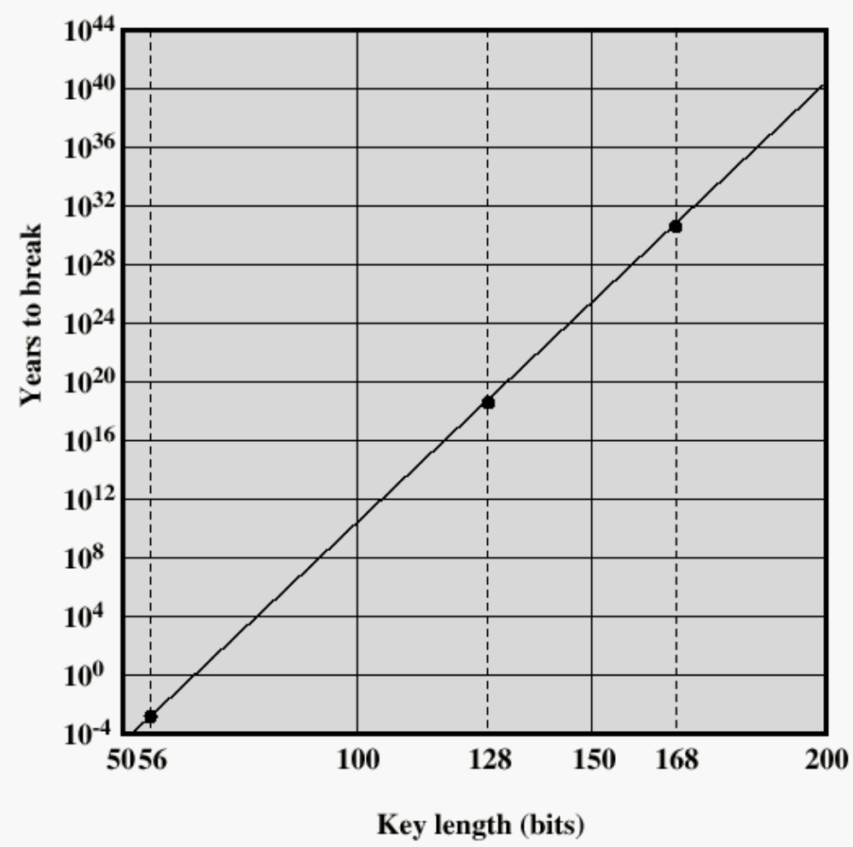
Time to break a code
(10⁶ decryptions/µs)

Slide 32
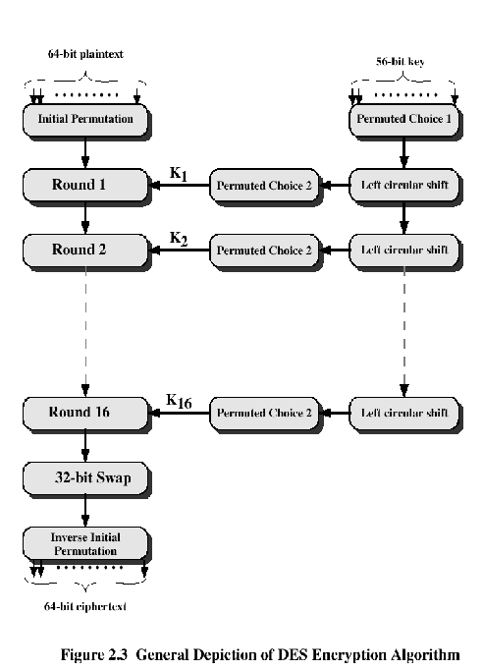

Slide 33

DES
The overall processing at each iteration:
  Li = Ri-1
  Ri = Li-1 F(Ri-1, Ki)
Its security Concerns about:
  The algorithm and the key length (56-bits)

Slide 34
Inside DES
cleartext
DES is a Feistel network with
  16 rounds
  64 bit cleartext blocks
  56 bits key
  k₁, …, k₁₆ derived from key
  Initial permutation π (public)
  Decryption
    Apply k₁₆, …, k₁ (in reverse order)
    Same chip
64
π
key
64
16-round
Feistel
Network
56
64
π⁻¹
64
ciphertext

Slide 35
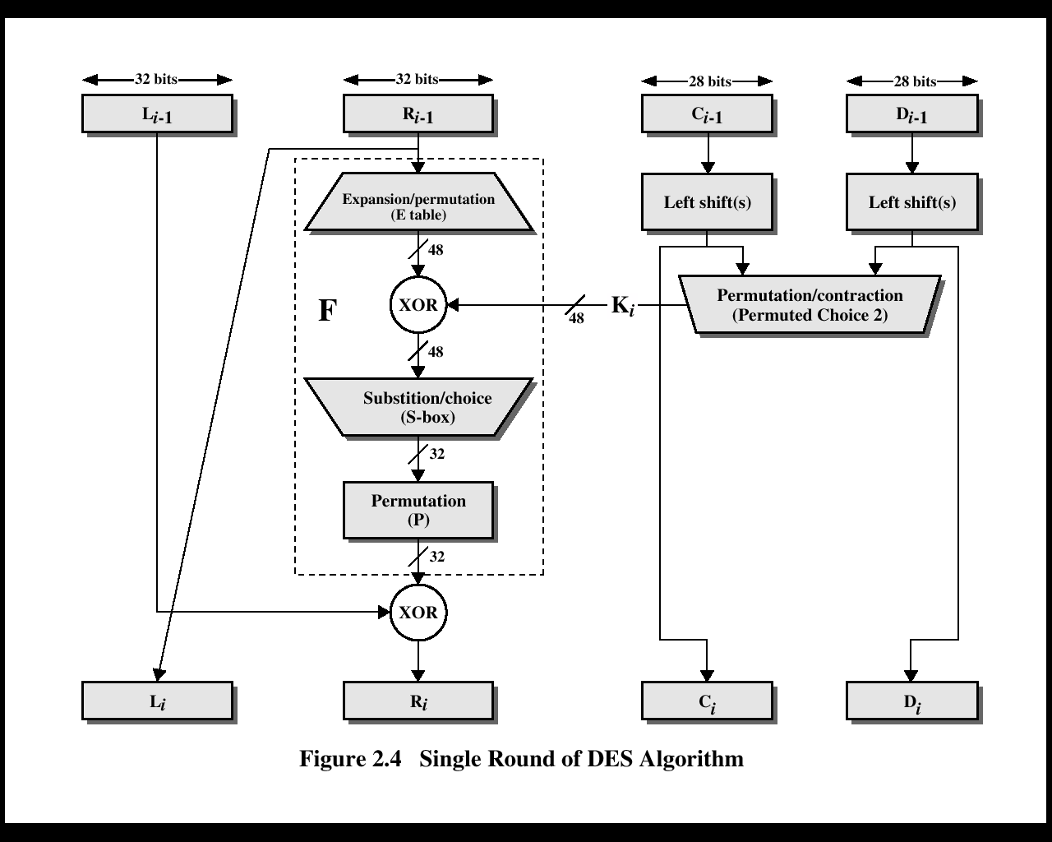

Slide 36
Inside DES
x₀ = IP(m) = L₀R₀.
16 Rounds, i = 1, 2, …, 16:
L_{i} := R_{i-1},
R_{i} := L_{i-1} ⊕ f (R_{i-1} , K_{i}),
where
f (R_{i-1} , K_{i}) = P(S(E(R_{i-1}) ⊕ K_{i})),
with operations: E (expansion),
S (S-box lookup), and P some
(permutation).
c = IP⁻¹(L₁₆R₁₆).

Slide 37
Initial Permutation
x₀ = IP(m) = L₀R₀
Initial Permutation
    58 50 42 34 26 18 10 2
    60 52 44 36 28 20 12 4
    62 54 46 38 30 22 14 6
    64 56 48 40 32 24 16 8
    57 49 41 33 25 17 9 1
    59 51 43 35 27 19 11 3
    61 53 45 37 29 21 13 5
    63 55 47 39 31 23 15 7

Slide 38
One Round of DES
L_{i-1}
R_{i-1}
Key_{i-1}
32
32
Shift
Shift
56
Expansion Permutation
Compression
Permutation
48
Feistel
Network
48
S-Box Substitution
32
P-Box Permutation
32
32
56
L_{i}
R_{i}
Key_{i}

Slide 39
Round function
The round function is:
g([L_{i-1},R_{i-1} ]),K_{i} ) = (L_{i} ,R_{i}),
where
L_{i} = R_{i-1} and R_{i} = L_{i-1} ⊕ f (R_{i-1} , K_{i} ).

Slide 40
f function
Combine 32 bit input and 48 bit key into 32 bit output
Expand 32 bits input to 48 bits
XOR the 48 bit key with the expanded 48 bit input
Apply the S-boxes to the 48 bit input to produce 32 bit output
Permute the resulting 32 bits

Slide 41
Expansion
f (R_{i-1} , K_{i}) = P(S(E(R_{i-1}) ⊕ K_{i}))
Expansion E :
    32 1 2 3 4 5
    4 5 6 7 8 9
    8 9 10 11 12 13
    12 13 14 15 16 17
    16 17 18 19 20 21
    20 21 22 23 24 25
    24 25 26 27 28 29
    28 29 30 31 32 1

Slide 42
S Boxes
f (R_{i-1} , K_{i}) = P(S (E(R_{i-1}) ⊕ K_{i}))
There are 8 different S-Boxes,1 for each chunk
S-box process maps 6 bit input to 4 bit output
S box performs substitution on 4 bits
There are 8 possible substitutions in each S box
Inner 4 bits are fed into an S box
Outer 2 bits determine which substitution is used

Slide 43
S-Box
48 bits ==> 32 bits. (8*6 ==> 8 *4)
2 bits used to select amongst 4 permutations for the rest of the 4-bit quantity
2 bits
row
I1
I2
I3
I4
I5
I6
S
O1
O2
O3
O4
i
4 bits
column
i
= 1,…8.

Slide 44
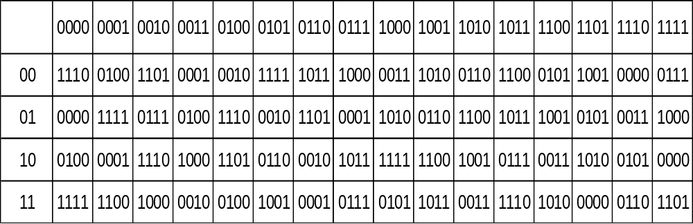
S Boxes
Use bits 1 & 6 to select the row
Bits 2-5 to select the substitution
Examples: 100101 will return 1000 (11 X 0010)
Notes:
100101 will return 1000 (11 X 0010)

Slide 45
S Boxes
Properties of S-boxes in DES
Each S-box has 6 input bits and 4 output bits. This was the largest that could be put on one chip back in 1974.
  All rows of all the S-boxes are permutations of 0, 1, …, 15
  S-Boxes are not affine transformations of their input
  Change in an input bit changes at least two output bits of the S-box
  For any x and any S-box S, S(x), S(x ⊕001100) differs by at least two bits

Slide 46
Permutation
f (R_{i-1} , K_{i}) = P(S(E(R_{i-1}) ⊕ K_{i}))
P fixed permutation
    16 7 20 21 29 12 28 17
    1 15 23 26 5 18 31 10
    2 8 24 14 32 27 3 9
    19 13 30 6 22 11 4 25
Result: bitstring of length 32!!

Slide 47
Per-Round Key Generation
Initial Permutation of DES key
C _{i-1}
28 bits
D _{i-1}
28 bits
Circular Left Shift
Circular Left Shift
One
round
Permutation
with Discard
Round 1,2,9,16:
single shift
Others: two bits
48 bits
K_{i}
C _{i}
28 bits
D _{i}
28 bits

Slide 48
Key schedule
Key schedule K₁, K₂,…, K₁₆
Discard the parity-check bits of K.
Compute PC-1(K) = C₀D₀,
where PC-1 is a fixed permutation,
C₀, D₀ left and right halves, 28-bit each.
For i = 1, 2, …, 16:
C_{i} := LS_{i}(C_{i-1}), D_{i} := LS_{i}(D_{i-1}),
where LS_{i} left cyclic shift of one
(i= 1, 2, 9, 16) or two positions (else),
K_{i} := PC-2(C_{i}D_{i}),
PC-2 fixed permutation selecting 48 bits.

Slide 49
Key schedule
PC-1(K) = C₀D₀
      57 49 41 33 25 17 9
      1 58 50 42 34 26 18
      2 59 51 43 35 27
      19 11 3 60 52 44 36
      63 55 47 39 31 23 15
      7 62 54 46 38 30 22
      6 61 53 45 37 29
      21 13 5 28 20 12 4
K_{i} := PC-2(C_{i} D_{i})
      14 17 11 24 1 5
      3 28 15 6 21 10
      23 19 12 4 26 8
      16 7 27 20 13 2
      41 52 31 37 47 55
      30 40 51 45 33 48
      44 49 39 56 34 53
      46 42 50 36 29 32

Slide 50
Final Permutations
The final permutation is the inverse of the initial permutation
c = IP⁻¹(R₁₆L₁₆)
    40 8 48 16 56 24 64 32
    39 7 47 15 55 23 63 31
    38 6 46 14 54 22 62 30
    37 5 45 13 53 21 61 29
    36 4 44 12 52 20 60 28
    35 3 43 11 51 19 59 27
    34 2 42 10 50 18 58 26
    33 1 41 9 49 17 57 25

Slide 51
Decrypting DES
How do we decrypt?: Decryption is performed by exactly the same procedure, except that the keys K₁,…, K₁₆ are used in reverse order. The reason why this works is the following:
The first decryption step takes R₁₆L₁₆ and gives the output: [L₁₆] [R₁₆ ⊕ f(L₁₆, K₁₆)]. But we know from the encryption procedure that:
L₁₆ = R₁₅; R₁₆ = L₁₅ ⊕ f(R₁₅, K₁₆). Therefore,
[R₁₅][L₁₅ ]=[L₁₆] [R₁₆ ⊕ f(R₁₅, K₁₆)] = [L₁₆] [R₁₆ ⊕ f(L₁₆, K₁₆)]

Slide 52
Decrypting DES
Similarly, the second step of decryption sends R₁₅L₁₅ to R₁₄L₁₄. Continuing we see that the decryption process leads us back to R₀L₀ as desired.
Note that the encryption process is essentially the same as the encryption process. Therefore both, the sender and the receiver use a common key and they can use identical machines.

Slide 53
Weak Keys
If all the bits in each half are either 0 or 1, then the key used for any cycle of the algorithm is the same for all the cycles of the algorithm.
There are 4 weak keys in the keyspace (2⁵⁶)
  *C₀ = All zeros & D₀ = All zeros
  C₀ = All ones & D₀ = All zeros
  C₀ = All zeros & D₀ = All ones
  C₀ = All ones & D₀ = All ones
* C_{o} and D_{o} are the 28 bit key halves
Notes:
C is the encryption key
D is the decryption key

Slide 54
Weak Keys
Additionally, some pairs of keys encrypt plaintext to the identical ciphertext. these keys generate only two different subkeys. Each of these subkeys is used eight times in the algorithm. These keys are called semiweak keys. There are 12 semi-weak keys.
Some keys produce only four subkeys, each used four times in the algorithm. There are 48 semi-weak keys.
Before condemning DES for having weak keys, consider that this list of 64 keys is minuscule compared to the total set of 72,057,594,037,927,936 possible keys.
Notes:
C is the encryption key
D is the decryption key

Slide 55
Algebraic Structure
If DES were closed, then for any K₁ and K₂ there would always be a K₃ such that E_{K2}(E_{K1}(P)) = E_{K3}(P)
  In other words, the DES encryption operation would form a group, and encrypting a set of plaintext blocks with K₁ followed by K₂ would be identical to encrypting the blocks with K₃.
  It wasn’t until 1992 that cryptographers proved that DES is not a group

Slide 56
Attacks on DES
Attacks on DES
1977, Diffie & Hellman suggested a VLSI chip that could test 10⁶ keys/sec. A machine with 10⁶ chips could test the entire key space in 10 hours. Cost: $20,000,000. 56-bit keys have 2⁵⁶ = 7.2 x 10¹⁶ values
1990, differential cryptanalysis, Eli Biham, Adi Shamir (Israel).
1993, linear cryptanalysis, Mitsuru Masui (Japan).
Notes:
- Brute force we've already discussed. If a suitable "Break DES" version were created, brute force could find the key in a matter of hours because of computing power advances.

Slide 57
DES variations
Double DES:
  Use 2 keys: K1 and K2.
  Encryption is E_{K1}(E_{K2}(P))
  Is double DES reducible to DES? (Crypto 92)
Triple DES
  Use 2 or 3 keys
  Encryption:
    E_{K1}(E_{K2}(E_{K3}(P))))
    E_{K1}(D_{K2}(E_{K1}(P))))

Slide 58
Avoiding Exhaustive Search–3DES
1. K1, K2 and K3 are independent keys;
2. K1 and K2 are independent keys and K3 = K1;
3. K1 = K2 = K3.
TDEA encryption operation
O = E_{K3}(D_{K2}(E_{K1}(m))).
2. TDEA decryption operation
O = D_{K1}(E_{K2}(D_{K3}(c)))
3DES_{k1,k2}(m) = E_{k1}(D_{k2}(E_{k1}(m)))
Key length: 112 bits
Very popular
DES
encryption
DES
encryption
DES
decryption

Slide 59
2DES
C=2DES_{k1,k2}(m) = E_{k1}( E_{k2}(m)) ??
Meet-in-the-middle attack!
X₁
m₁
For key length n,
total work is “only”
2^{n} + 2^{n} = 2^{n+1}
E
X₂
= ?
m₂
m
D
C
…
…
X₂
56
m₂
56
Try all possible keys
Effective key length is just 57 bits!
Applies to any encryption algorithm

Slide 60
Meet-in the middle attack
Assume Eve has intercepted a message m and a doubly encrypted ciphertext c = E_{k2}(E_{k1}(m)). She wants to find k₁ and k₂.
She first computes and stores E_{k}(m) for all possible keys k.
She then computes D_{k}(c) for all possible keys k.
Finally she compares both lists. She knows as a fact that there will be at least one match, since the correct pair of keys should be one of them.

Slide 61
DESX
DES
encryption
DESX_{k1,k2,k3}(m) = k1 ⊕ E_{k2}(m ⊕ k3)
DESX is a DES variant from RSA Data Security, Inc. that has been included in the MailSafe electronic mail security program since 1986 and the BSAFE toolkit since 1987.
Key length: 56 + 2*64 = 184 bits
However, effective key length is only about 100 bits

Slide 62
International Data Encryption Standard (IDEA)
Developed in Switzerland. The first incarnation of the IDEA cipher, by Xuejia Lai and James Massey, surfaced in 1990 . It was called PES (Proposed Encryption Standard).
IPES (Improved Proposed Encryption Standard) , IDEA (International Data Encryption Algorithm) in 1992
128 bit key, 64 bit blocksize, 8 rounds
Current software implementations of IDEA are about twice as fast as DES.
used in Pretty Good Privacy (PGP)

Slide 63
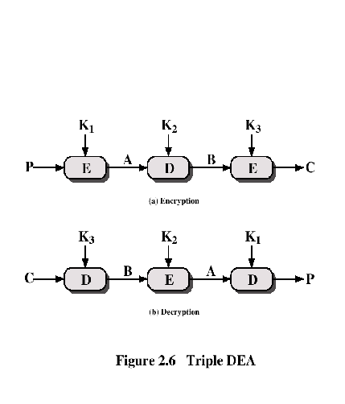
Triple DEA

Slide 64
Other Symmetric Block Ciphers
International Data Encryption Algorithm (IDEA)
  128-bit key
  Used in PGP
Blowfish
  Easy to implement
  High execution speed
  Run in less than 5K of memory

Slide 65
Other Symmetric Block Ciphers
RC5
  Suitable for hardware and software
  Fast, simple
  Adaptable to processors of different word lengths
  Variable number of rounds
  Variable-length key
  Low memory requirement
  High security
  Data-dependent rotations
Cast-128
  Key size from 40 to 128 bits
  The round function differs from round to round

Slide 66
2.3 Random Numbers
many uses of random numbers in cryptography
  Nonces (number once) in authentication protocols to prevent replay
  session keys
  public key generation
  keystream for a one-time pad
in all cases its critical that these values be
  statistically random, uniform distribution, independent
  unpredictability of future values from previous values
true random numbers provide this
care needed with generated random numbers

Slide 67
Pseudorandom Number Generators (PRNGs)
often use deterministic algorithmic techniques to create “random numbers”
  although are not truly random
  can pass many tests of “randomness”
known as “pseudorandom numbers”
created by “Pseudorandom Number Generators (PRNGs)”
Notes:
Cryptographic applications typically make use of deterministic algorithmic techniques for random number generation, producing sequences of numbers that are not statistically random, but if the algorithm is good, the resulting sequences will pass many reasonable tests of randomness. Such numbers are referred to as pseudorandom numbers, created by “Pseudorandom Number Generators (PRNGs)”.

Slide 68
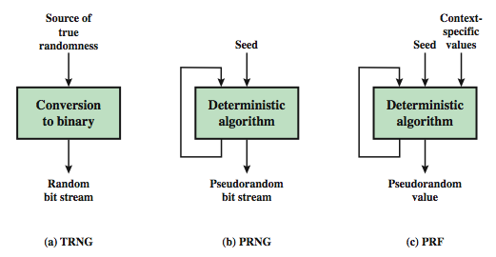
Random & Pseudorandom Number Generators
Notes:
Stallings Figure 2.77 contrasts a true random number generator (TRNG) with two forms of pseudorandom number generators. A TRNG takes as input a source that is effectively random; the source is often referred to as an entropy source. In contrast, a PRNG takes as input a fixed value, called the seed, and produces a sequence of output bits using a deterministic algorithm. Typically, as shown, there is some feedback path by which some of the results of the algorithm are fed back as input as additional output bits are produced. The important thing to note is that the output bit stream is determined solely by the input value or values, so that an adversary who knows the algorithm and the seed can reproduce the entire bit stream.
Figure 7.1 shows two different forms of PRNGs, based on application;
• Pseudorandom number generator: An algorithm that is used to produce an open-ended sequence of bits is referred to as a PRNG. A common application for an open-ended sequence of bits is as input to a symmetric stream cipher, as discussed in Section 7.4. Also, see Figure 3.1a.
• Pseudorandom function (PRF): A PRF is used to produced a pseudorandom string of bits of some fixed length. Examples are the symmetric encryption keys and nonces. Typically, the PRF takes as input a seed plus some context specific values, such as a user ID or an application ID.

Slide 69

2.4 Stream Cipher Structure
Notes:
Stallings Figure 2.8 illustrates the general structure of a stream cipher, where a key is input to a pseudorandom bit generator that produces an apparently random keystream of bits, and which are XOR’d with message to encrypt it, and XOR’d again to decrypt it by the receiver.

Slide 70
Stream Cipher Properties
some design considerations are:
  long period with no repetitions
  statistically random
  depends on large enough key
  large linear complexity
properly designed, can be as secure as a block cipher with same size key
but usually simpler & faster
Notes:
[KUMA97] lists the following important design considerations for a stream cipher:
The encryption sequence should have a large period, the longer the period of repeat the more difficult it will be to do cryptanalysis.
The keystream should approximate the properties of a true random number stream as close as possible, the more random-appearing the keystream is, the more randomized the ciphertext is, making cryptanalysis more difficult.
To guard against brute-force attacks, the key needs to be sufficiently long. The same considerations as apply for block ciphers are valid here .Thus, with current technology, a key length of at least 128 bits is desirable.
With a properly designed pseudorandom number generator, a stream cipher can be as secure as block cipher of comparable key length. The primary advantage of a stream cipher is that stream ciphers are almost always faster and use far less code than do block ciphers. A stream cipher can be constructed with any cryptographically strong PRNG.

Slide 71
RC4
a proprietary cipher owned by RSA DSI
another Ron Rivest design, simple but effective
variable key size, byte-oriented stream cipher
widely used (web SSL/TLS, wireless WEP/WPA)
key forms random permutation of all 8-bit values
uses that permutation to scramble input info processed a byte at a time
Notes:
RC4 is a stream cipher designed in 1987 by Ron Rivest for RSA Security. It is a variable key-size stream cipher with byte-oriented operations. The algorithm is based on the use of a random permutation. Analysis shows that the period of the cipher is overwhelmingly likely to be greater than 10^100. Eight to sixteen machine operations are required per output byte, and the cipher can be expected to run very quickly in software. RC4 is probably the most widely used stream cipher. It is used in the SSL/TLS secure web protocol, & in the WEP & WPA wireless LAN security protocols. RC4 was kept as a trade secret by RSA Security, but in September 1994 was anonymously posted on the Internet on the Cypherpunks anonymous remailers list. In brief, the RC4 key is ued to form a random permutation of all 8-bit values, it then uses that permutation to scramble input info processed a byte at a time.

Slide 72
RC4 Key Schedule
starts with an array S of numbers: 0..255
use key to well and truly shuffle
S forms internal state of the cipher
  for i = 0 to 255 do
    S[i] = i //state S
    T[i] = K[i mod keylen]) //repeated K->T
  j = 0
  for i = 0 to 255 do
    j = (j + S[i] + T[i]) (mod 256)
    swap (S[i], S[j])
Notes:
The RC4 algorithm is remarkably simple and quite easy to explain. It uses a variable-length key of from 1 to 256 bytes. The RC4 key schedule initialises the state S to the numbers 0..255, and then walks through each entry in turn, using its current value plus the next byte of key to pick another entry in the array, and swaps their values over. After doing this 256 times, the result is a well and truly shuffled array. The total number of possible states is 256! - a truly enormous number, much larger even than the 2048-bit (256*8) max key allowed can select.

Slide 73
RC4 Encryption
encryption continues shuffling array values
sum of shuffled pair selects "stream key" value from permutation
XOR S[t] with next byte of message to en/decrypt
  i = j = 0
  for each message byte M_{i}
    i = (i + 1) (mod 256)
    j = (j + S[i]) (mod 256)
    swap(S[i], S[j])
    t = (S[i] + S[j]) (mod 256)
    C_{i} = M_{i} XOR S[t]
Notes:
To form the stream key for en/decryption (which are identical), RC4 continues to shuffle the permutation array S by continuing to swap each element in turn with some other entry, and using the sum of these two entry values to select another value from the permutation to use as the stream key, which is then XOR’d with the current message byte.

Slide 74
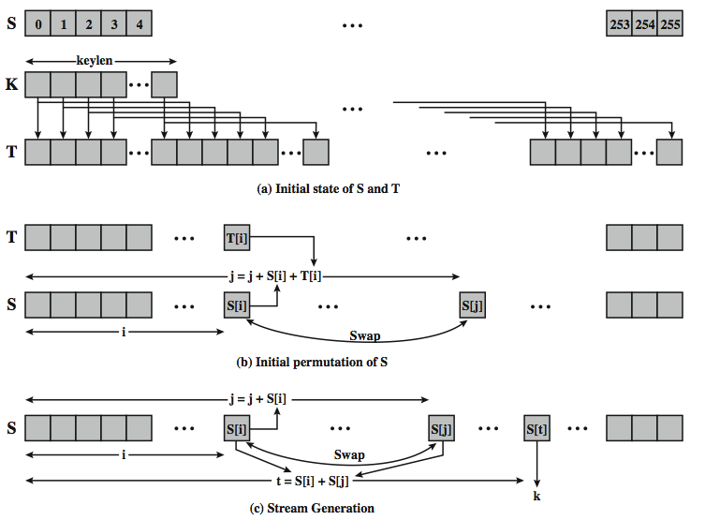
RC4 Overview
Notes:
Stallings Figure 2.9 illustrates the general structure of RC4.

Slide 75
RC4 Security
claimed secure against known attacks
  have some analyses, none practical
result is very non-linear
since RC4 is a stream cipher, must never reuse a key
have a concern with WEP, but due to key handling rather than RC4 itself
Notes:
A number of papers have been published analyzing methods of attacking RC4, but none of these approaches is practical against RC4 with a reasonable key length, such as 128 bits.
A more serious problem occurs in its use in the WEP protocol, not with RC4 itself but the way in which keys are generated for use as input to RC4.
Currently RC4 its regarded as quite secure, if used correctly, with a sufficiently large key.

Slide 76
2.5 Cipher Block Modes of Operation
block ciphers encrypt fixed size blocks
  eg. DES encrypts 64-bit blocks with 56-bit key
need some way to en/decrypt arbitrary amounts of data in practise
NIST SP 800-38A defines 5 modes
have block and stream modes
to cover a wide variety of applications
can be used with any block cipher
Notes:
DES (or any block cipher) forms a basic building block, which en/decrypts a fixed sized block of data. However to use these in practise, we usually need to handle arbitrary amounts of data, which may be available in advance (in which case a block mode is appropriate), and may only be available a bit/byte at a time (in which case a stream mode is used). To apply a block cipher in a variety of applications, five "modes of operation" have been defined by NIST (SP 800-38A). In essence, a mode of operation is a technique for enhancing the effect of a cryptographic algorithm or adapting the algorithm for an application, such as applying a block cipher to a sequence of data blocks or a data stream. The five modes are intended to cover a wide variety of applications of encryption for which a block cipher could be used. These modes are intended for use with any symmetric block cipher, including triple DES and AES. .

Slide 77
Electronic Codebook Book (ECB)
message is broken into independent blocks which are encrypted
each block is a value which is substituted, like a codebook, hence name
each block is encoded independently of the other blocks
  C_{i} = E_{K}(P_{i})
uses: secure transmission of single values
Notes:
The simplest mode is the electronic codebook (ECB) mode, in which plaintext is handled one block at a time and each block of plaintext is encrypted using the same key. The term codebook is used because, for a given key, there is a unique ciphertext for every b-bit block of plaintext. Therefore, we can imagine a gigantic codebook in which there is an entry for every possible b-bit plaintext pattern showing its corresponding ciphertext. For a message longer than b bits, the procedure is simply to break the message into b-bit blocks, padding the last block if necessary. Decryption is performed one block at a time, always using the same key. ECB is the simplest of the modes, and is used when only a single block of info needs to be sent (eg. a session key encrypted using a master key).

Slide 78
Advantages and Limitations of ECB
message repetitions may show in ciphertext
  if aligned with message block
  particularly with data such graphics
  or with messages that change very little, which become a code-book analysis problem
weakness is due to the encrypted message blocks being independent
main use is sending a few blocks of data
Notes:
For lengthy messages, the ECB mode may not be secure. If the message is highly structured, it may be possible for a cryptanalyst to exploit these regularities. If the message has repetitive elements, with a period of repetition a multiple of b bits, then these elements can be identified by the analyst. This may help in the analysis or may provide an opportunity for substituting or rearranging blocks. Hence ECB is not appropriate for any quantity of data, since repetitions can be seen, esp. with graphics, and because the blocks can be shuffled/inserted without affecting the en/decryption of each block. Its main use is to send one or a very few blocks, eg a session encryption key.

Slide 79
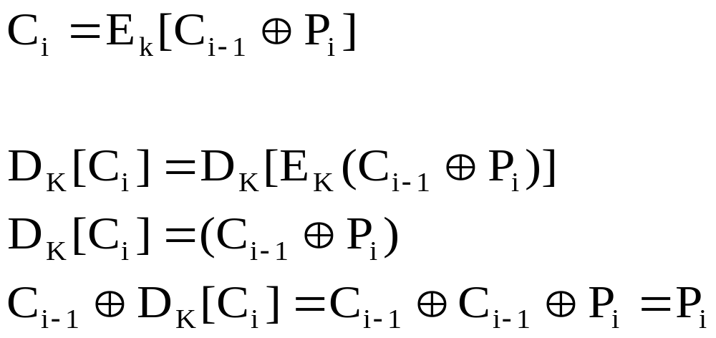
Cipher Block Chaining (CBC)
message is broken into blocks
linked together in encryption operation
each previous cipher blocks is chained with current plaintext block, hence name
use Initial Vector (IV) to start process
uses: bulk data encryption, authentication
Notes:
To overcome the problems of repetitions and order independence in ECB, want some way of making the ciphertext dependent on all blocks before it. The CBC provides this, by combining the previous ciphertext block with the current message block before encrypting. In effect, we have chained together the processing of the sequence of plaintext blocks. The input to the encryption function for each plaintext block bears no fixed relationship to the plaintext block. Therefore, repeating patterns of b bits are not exposed. For decryption, each cipher block is passed through the decryption algorithm. The result is XORed with the preceding ciphertext block to produce the plaintext block. To produce the first block of ciphertext, an initialization vector (IV) is XORed with the first block of plaintext. On decryption, the IV is XORed with the output of the decryption algorithm to recover the first block of plaintext. The IV is a data block that is that same size as the cipher block, and is either well known (often all 0's), or otherwise is sent, ECB encrypted, just before starting CBC use. CBC mode is applicable whenever large amounts of data need to be sent securely, provided that all data is available in advance (eg email, FTP, web etc).

Slide 80
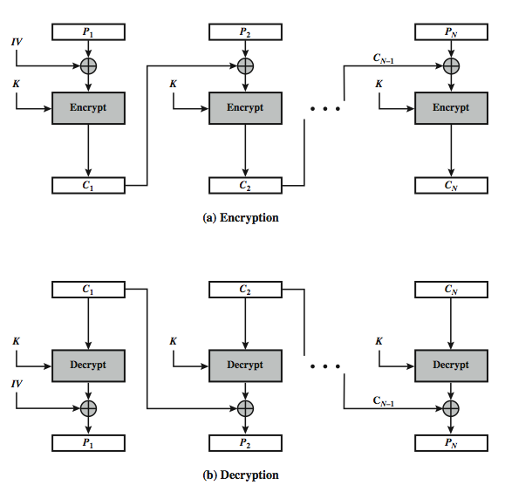
Cipher Block Chaining (CBC)
Notes:
Stallings Figure 2.10 illustrates the Cipher Block Chaining (CBC) Mode.

Slide 81
Cipher FeedBack (CFB)
message is treated as a stream of bits
added to the output of the block cipher
result is feed back for next stage (hence name)
standard allows any number of bit (1,8, 64 or 128 etc) to be feed back
  denoted CFB-1, CFB-8, CFB-64, CFB-128 etc
most efficient to use all bits in block (64 or 128)
  C_{i} = P_{i} XOR E_{K}(C_{i-1})
  C₋₁ = IV
uses: stream data encryption, authentication
Notes:
Cipher feedback (CFB) mode is one alternative. As with CBC, the units of plaintext are chained together, so that the ciphertext of any plaintext unit is a function of all the preceding plaintext. In this case, rather than units of b bits, the plaintext is divided into segments of s bits. The input to the encryption function is a b-bit shift register that is initially set to some initialization vector (IV). The leftmost (most significant) s bits of the output of the encryption function are XORed with the first segment of plaintext P1 to produce the first unit of ciphertext C1, which is then transmitted. In addition, the contents of the shift register are shifted left by s bits and C1 is placed in the rightmost (least significant) s bits of the shift register. This process continues until all plaintext units have been encrypted. For decryption, the same scheme is used, except that the received ciphertext unit is XORed with the output of the encryption function to produce the plaintext unit. Note that it is the encryption function that is used, not the decryption function.
As originally defined, CFB was to "consume" as much of the "random" output as needed for each message unit (bit/byte) before "bumping" bits out of the buffer and re-encrypting. This is wasteful though, and slows the encryption down as more encryptions are needed. An alternate way to think of it is to generate a block of "random" bits, consume them as message bits/bytes arrive, and when they're used up, only then feed a full block of ciphertext back. This is CFB-64 or CFB-128 mode (depending on the block size of the cipher used eg DES or AES respectively). CFB is the usual choice for quantities of stream oriented data, and for authentication use.

Slide 82
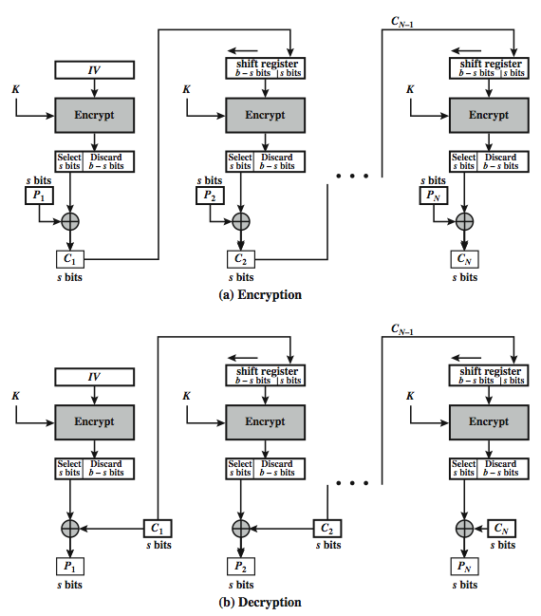
s-bit
Cipher FeedBack (CFB-s)
Notes:
Stallings Figure 2.11 illustrates the operation of s-bit Cipher FeedBack (CFB) Mode.

Slide 83
Advantages and Limitations of CFB
appropriate when data arrives in bits/bytes
most common stream mode
limitation is need to stall while do block encryption after every n-bits
note that the block cipher is used in encryption mode at both ends
errors propogate for several blocks after the error
Notes:
CFB is the usual stream mode. As long as can keep up with the input, doing encryptions every 8 bytes. A possible problem is that if its used over a "noisy" link, then any corrupted bit will destroy values in the current and next blocks (since the current block feeds as input to create the random bits for the next). So either must use over a reliable network transport layer (typical) or use OFB/CTR.

Slide 84
Counter (CTR)
a “new” mode, though proposed early on
similar to OFB but encrypts counter value rather than any feedback value
must have a different key & counter value for every plaintext block (never reused)
  O_{i} = E_{K}(i)
  C_{i} = P_{i} XOR O_{i}
uses: high-speed network encryptions
Notes:
The Counter (CTR) mode is a variant of OFB, but which encrypts a counter value (hence name). Although it was proposed many years before, it has only recently been standardized for use with AES along with the other existing 4 modes. It is being used with applications in ATM (asynchronous transfer mode) network security and IPSec (IP security). A counter, equal to the plaintext block size is used. The only requirement stated in SP 800-38A is that the counter value must be different for each plaintext block that is encrypted. Typically the counter is initialized to some value and then incremented by 1 for each subsequent block. As with the OFB mode, the initial counter value must be a nonce; be different for all of the messages encrypted using the same key. Further, all counter values across all messages must be unique. If, contrary to this requirement, a counter value is used multiple times, then the confidentiality of all of the plaintext blocks corresponding to that counter value may be compromised.

Slide 85
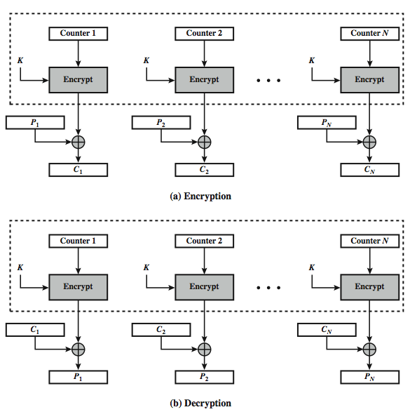
Counter (CTR)
Notes:
Stallings Figure 2.11 illustrates the Counter (CTR) Mode.

Slide 86
Advantages and Limitations of CTR
efficiency
  can do parallel encryptions in h/w or s/w
  can preprocess in advance of need
  good for bursty high speed links
random access to encrypted data blocks
provable security (good as other modes)
but must ensure never reuse key/counter values, otherwise could break (cf OFB)
Notes:
CTR mode has a number of advantages in parallel h/w & s/w efficiency, can preprocess the output values in advance of needing to encrypt, can get random access to encrypted data blocks, and is simple. But like OFB have issue of not reusing the same key+counter value.

Slide 87
2.5 Cipher Block Modes of Operation
Cipher Block Chaining Mode (CBC)
  The input to the encryption algorithm is the XOR of the current plaintext block and the preceding ciphertext block.
  Repeating pattern of 64-bits are not exposed

Slide 88
Recommended Reading
Stallings, W. Cryptography and Network Security: Principles and Practice, 2nd edition. Prentice Hall, 1999
Scneier, B. Applied Cryptography, New York: Wiley, 1996
Mel, H.X. Baker, D. Cryptography Decrypted. Addison Wesley, 2001

